Slide 1

Insurance Claim Prediction
By Wenslo Dort

Slide 2

Purpose
My primary goal was to uncover which features most influence whether a policyholder will file a claim. I wanted to delve into the data and identify key drivers behind claim behavior

Slide 3
Problem & Data Overview
Problem Statement: Predict whether a policyholder will file a claim in the next six months.
Data Snapshot: 58,592 observations, 44 variables (policy, vehicle, and geographic features).
Clean dataset with no missing values.
Challenge: Imbalanced data (only ~6% of policyholders filed a claim)

Slide 4
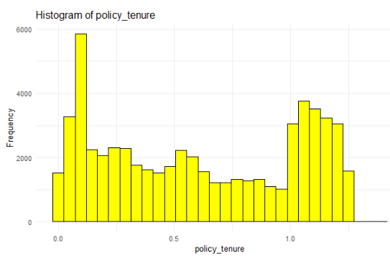
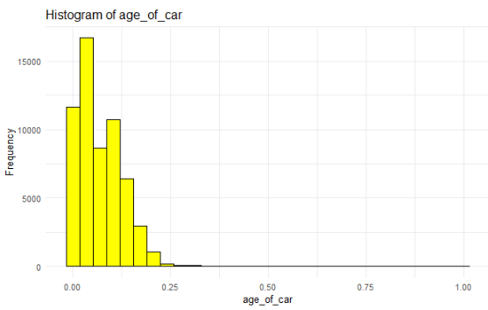
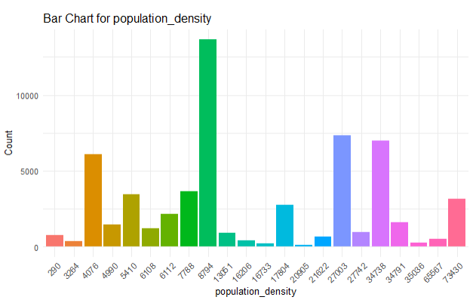
EDA
Major Findings: Policy tenure is bimodal (new vs. long-term customers).
Most vehicles are compact/subcompact—with typical safety and engine features.
Safety features such as airbags and NCAP ratings, along with population density, provide important clues even if single predictors show a weak linear correlation

Slide 5
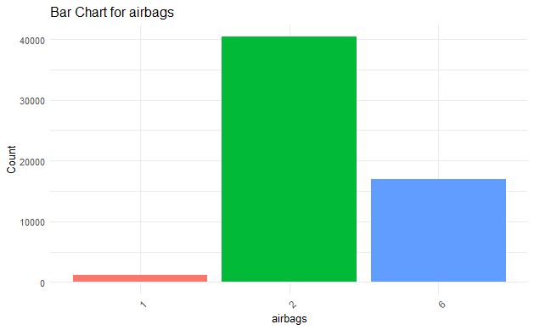
EDA
Some numerical variables:
age_of_car
policy_tenure
population_density
Displacement
Cylinder
Airbags
ncap_rating – standardized crash safety rating.
Some binary Variables
is_esc – Electronic Stability Control
is_tpms – Tire Pressure Monitoring System
is_parking_sensors
is_parking_camera
is_front_fog_lights

Slide 6
Modeling Approach
Models used:
Logistic Regression (baseline)
LASSO & Ridge (handle multicollinearity)
Random Forest (nonlinear interactions)
Evaluation metrics: Accuracy, AUC, Sensitivity, Specificity, F1 Score
Thresholds tested (0.1 to 0.9) to handle class imbalance
Notes:
Ensemble methods helped capture complex non-linear interactions.

Slide 7
Results & Performance
Model | Sensitivity | Balanced Accuracy | AUC
Logistic Regression | 0.9242 | 0.5209 | 0.6121
LASSO Regression | 0.9350 | 0.5229 | 0.6114
Ridge Regression | 0.9344 | 0.5213 | 0.6111
Random Forest | 0.0067 | 0.5013 | 0.5114
LASSO Regression edges out the others slightly with the highest balanced accuracy (0.5229) and strong sensitivity (0.935), while having an AUC very close to the logistic regression model.
It also applies regularization, reducing overfitting risk — a valuable trait when working with sparse positive cases.

Slide 8
Conclusions & Next Steps
Threshold tuning is crucial when working with imbalanced datasets
Most models were good at identifying non-claimants but weak at detecting claimants
Model success limited by data imbalance
Future work: Boosting methods

Slide 9
Reflection
Biggest challenge: Cleaning and encoding variables with many NaN values
Takeaway: Class imbalance significantly affects model metrics
Next steps (if more time): Explore XGBoost or SVM

